Slide 1
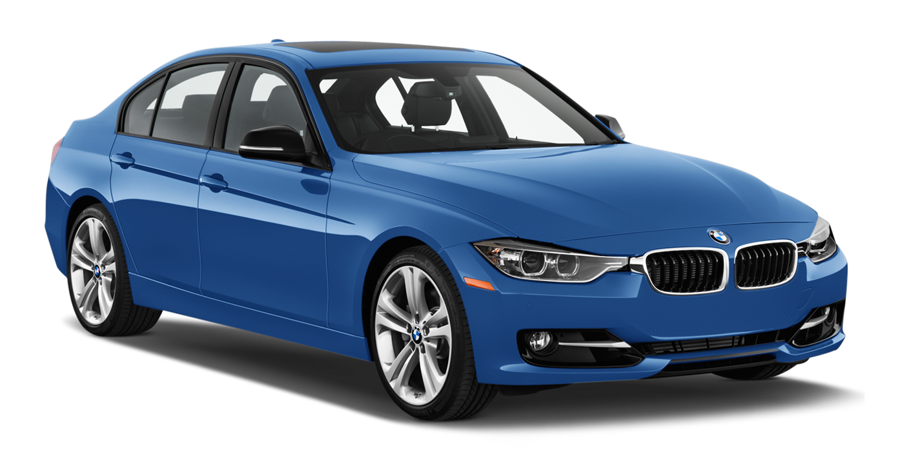

Abstraction and Encapsulation
Car Functionality:
Rolling up the windows (simple)
Transferring gas to the engine (complicated)
User
public
accelerate()
private
public
gas_to_engine()

